Slide 1
Portfolios
Interactive Media
Unit 1

Slide 2
Starter – 5 Minutes
In rows, discuss the following questions, answer on your whiteboards:
What is a portfolio?
What do you think would go in a portfolio?
What do you think an Interactive Media portfolio looks like?
Notes:
How presentation will benefit audience: Adult learners are more interested in a subject if they know how or why it is important to them.
Presenter’s level of expertise in the subject: Briefly state your credentials in this area, or explain why participants should listen to you.

Slide 3

Learning Outcomes
Aspire to ……
 | Explain the components of a high-quality portfolio.
Challenge to……
 | Describe how to build a portfolio.
 | Understand what a portfolio is and what it contains.

Slide 4
Learning Outcomes
Understand what a portfolio is and what it contains.
Describe how to build a portfolio.
Explain the components of a high-quality portfolio.

Slide 5
What is a “Portfolio”?
A large, thin, flat case for loose sheets of paper such as drawings or maps.
A range of investments held by a person or organisation.
Where do you think I got these definitions from?
Do you think they are correct?

Slide 6
Internet Research
A lot of this course includes research into multiple topics.
Be careful not to grab the first answer you find on the internet!

Slide 7
So what really is a “Portfolio”?
A portfolio is a collection of materials.
These can be either physical or digital.
These materials act as an advertisement for your skills in a particular area.
An artist would have a collection of all of their best pieces of art.
For an interactive media product, this will be a reflection of your skills.

Slide 8
Task 1 – What skills?
Discuss with your neighbour, then fill in your answers in the worksheet:
What skills do you think are needed to make an interactive media product? List five or more.
Describe how you would display those skills in a portfolio.
Explain the difference between a good example and a bad example of those skills.

Slide 9
Example Portfolio
The following samples are taken from the specification.
The details covered in the samples are from LO2 (later in this unit), however you will be producing your portfolio from LO1 onwards.

Slide 10
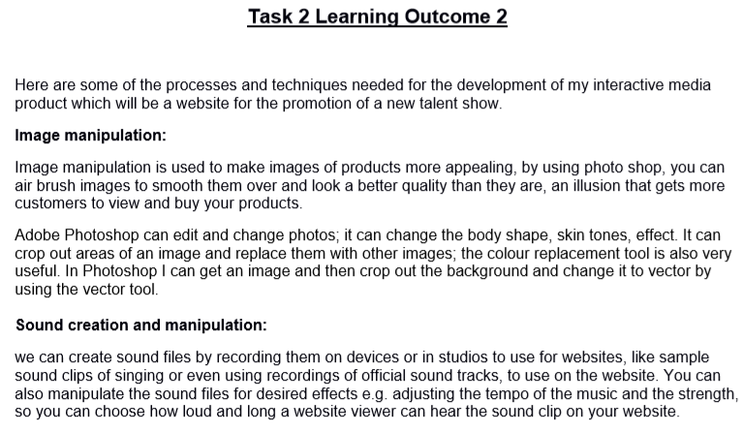
Example Portfolio

Slide 11
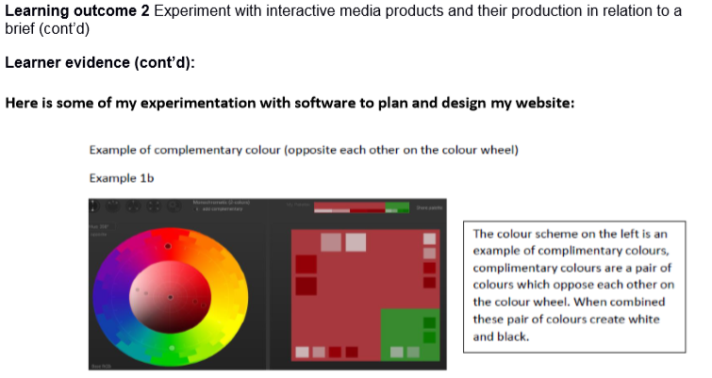
Example Portfolio

Slide 12
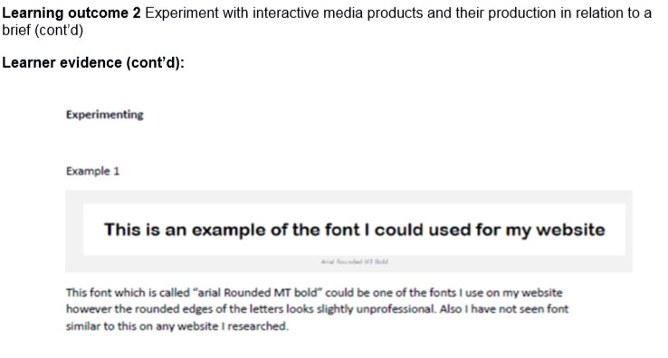
Example Portfolio

Slide 13
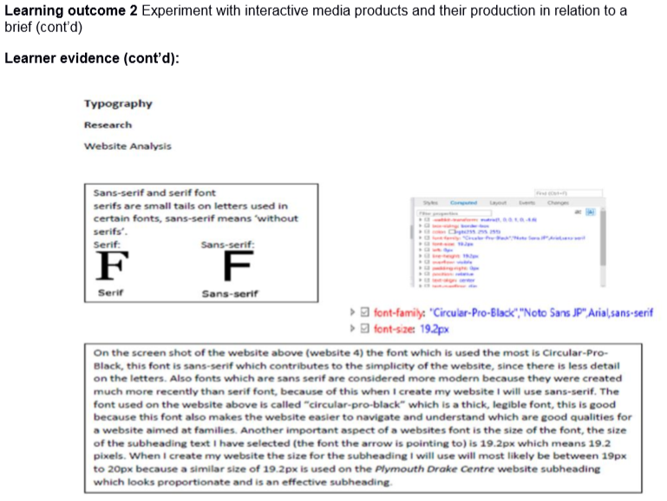
Example Portfolio

Slide 14
Understanding a Portfolio
For this course, creating a portfolio has two purposes:
To show evidence of you skills and to prove that you have gone through the necessary steps to learn those skills.
To show progress throughout the course. – Your portfolio at the end of the year should look much better than it did at the start.

Slide 15
Format of a Portfolio
Portfolios can come in many different formats; the format chosen can help present your skills in a particular area.
You may choose later on to change the format of your portfolio to help demonstrate your skills in that area.

Slide 16
How to start?
Starting a portfolio may seem like a daunting task…
So that’s what we’re going to do!

Slide 17
Task 2 – Creating a Portfolio
For now, your portfolio will be kept simple.
It must cover the following information:
Your name
The name of the course
Creation date
List of sections
More information can be found in the worksheet.
Notes:
Demonstrate how to create a portfolio here.
Show the steps needed to add a cover page, some sample headings and the contents page.
Show the students how to update the contents page.

Slide 18
Creating a Portfolio
Watch the demonstration carefully on how to create a cover page and add headings.

Slide 19
Plenary – How to Improve
Right now, all of you will have similar portfolios. Answer the following questions on your whiteboards:
What skills do you think your portfolio show off at the moment?
How do you think you would show off more skills in your portfolio?
What could you change about the portfolio in order to show off more skills related to interactive media products?

